Slide 1
Project Overview
Stock Portfolio Builder Spyder01 By Charles, Yulian and Tim

Slide 2

Project Goals
The goal of the Stock Portfolio Builder (SPB) project is to create a program that helps individuals build a diversified stock portfolio based on the risk and the investment amount they choose.
The program will generate four stocks that best match the user’s preference.
Then there’s an additional option of emailing the final portfolio to user.
Overall this project makes portfolio creation accessible, informative, and efficient for all types of investors.

Slide 3
Description
The Stock Portfolio Builder (SPB) is simply a user-friendly tool that helps both new and experienced investors how to invest their money in the stock market.
The user will enter the amount of money they would like to invest then will be asked to choose between high, active, or low stock performance.
The program will then recommend four stocks to the user and divide the money evenly among them.
Then the user will have the option to have the portfolio emailed to them.

Slide 4
Use Cases
First Use Case
An user who is new to the stock market wants help in choosing where they should invest their money. They enter the amount they want to invest and choose the low performance option. SPB will then display four stocks and their information based on the user’s choice. The user chooses to have the information emailed to them. This gives the user a simple way to build a portfolio without being well versed in the stock market.
Second Use Case
An experienced investor in the stock market uses SPB to get more insight about high performance stocks. SPB displays four stocks and now the user can use the recommended stocks and compare them with their own stock market strategies. Using SPB simply as a tool to get some quick insight.

Slide 5
Technology
APIs
Alpha Vantage: An API that provides real-time and historical financial data. You can easily access stock market data, company information, and stock market trends by sending web requests. The data is returned in JSON format.
SendGrid: An email API that allows you to emails automatically in Python. The stock portfolio was emailed to the user with Sendgrid
Modules
Requests: this module allows you to send HTTP requests to web servers. This module was used to retrieve the real-time stock data from the Alpha Vantage API
SendgridAPIClient: this module enabled python to actually send the
Information to the user’s email. This module automatically access the
Sendgrid library so it makes sending the email less complex

Slide 6
Program Flow
How the Program Works
The user will enter the amount they want to invest
Then they will have the option of high, active, or low stock performance
The program will retrieve four stocks using Alpha Vantage which match the user’s choice
The investment amount will be evenly divided among the four stocks
The portfolio will displayed to the user
The user will have the option to have the portfolio emailed to them
If they choose yes, the program will send the information using
Sendgrid. If not then the program will end.
Error handling is used to check for valid input

Slide 7
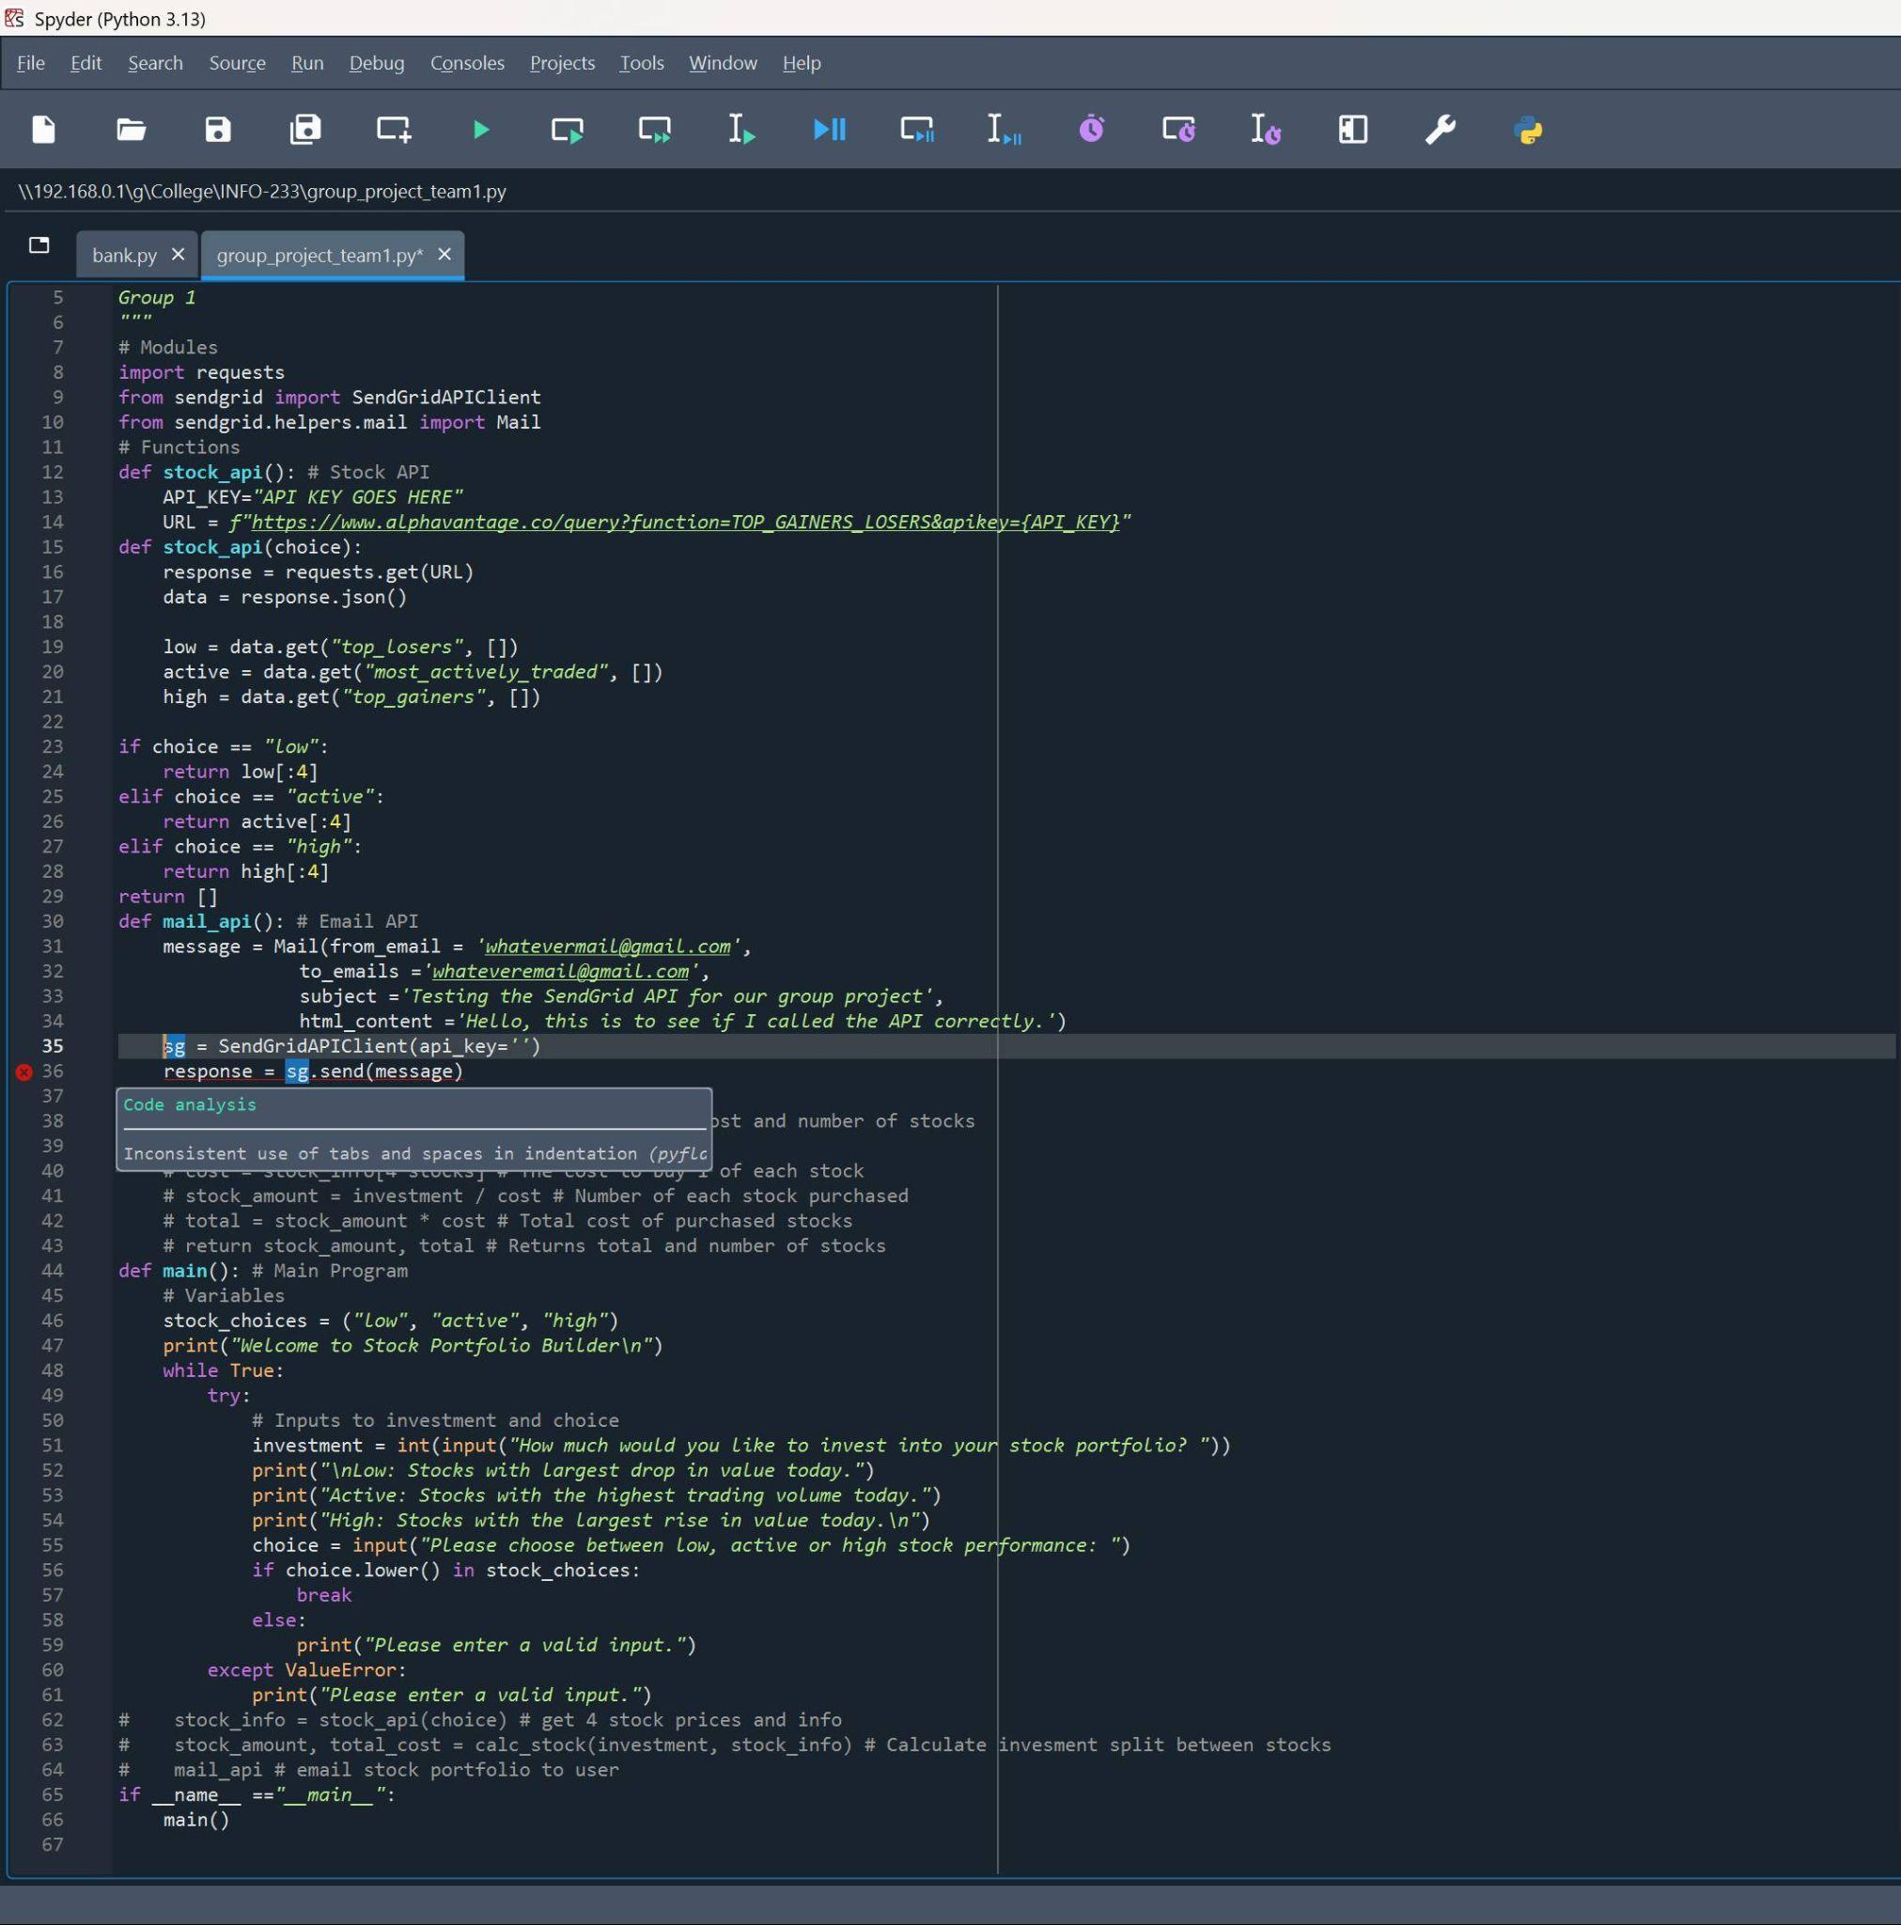
Document One Error
We encountered an error where the Sendgrid API key was not working.
It was resolved by applying for a new API key at the Sendgrid website.
Also, in the screenshot below, it shows we created a variable named “response” but that variable was never used.
The original code is:
response = sg.send(message)
To fix this error we simply removed the response Variable.
The fixed code is:
sg.send(message)

Slide 8
Team Members
Charles
Phase 1 - Research and design of Stock Portfolio Builder.
Phase 2 - Main and Calculation functions. QA, edit, and error corrections.
Phase 3 - Edit design.
Yulian
Phase 1 research for stock API.
Integrated the AlphaVantage API to deliver stock data, including company names, ticker symbols, and descriptive summaries.
Tim
Contributed by choosing the email API. Defined the function for sending the email and using the correct API documentation for the API call to work correctly.
Phase 3 Presentation creation.

Slide 9
Related Documents
API Sources
Alpha Vantage API: https://www.alphavantage.co/
Sendgrid API: https://sendgrid.com/en-us

Slide 10
Questions?
Do you have any questions for us?

